Slide 1
Lecture # 10
By: Muhammad Zain Uddin
email: zuddin@iba.edu.pk

Slide 2
Attribution
Today’s lecture is based on lecture on Martin Kleppmann’s Distributed System Lecture Series

Slide 3
Agenda
What is Distributed Computing (or Systems)
Why make a system distributed? Why not?
Latency and Bandwidth
Remote Procedure Call (RPC)
Model of Distributed Systems
Two generals problem
Byzantine generals problem
System Model

Slide 4
A distributed system is. . .
“. . . a system in which the failure of a computer you didn’t even know existed can render your own computer unusable.” — Leslie Lamport
multiple computers communicating via a network
trying to achieve some task together
Consists of “nodes” (computer, phone, car, robot, . . . )

Slide 5
Why make a system distributed?
It’s inherently distributed:
e.g. sending a message from your mobile phone to your friend’s phone
For better reliability:
even if one node fails, the system as a whole keeps functioning
For better performance:
get data from a nearby node rather than one halfway round the world
To solve bigger problems:
e.g. huge amounts of data, can’t fit on one machine

Slide 6
Why NOT make a system distributed?
The trouble with distributed systems:
Communication may fail (and we might not even know it has failed)
Processes may crash (and we might not know)
All of this may happen non-deterministically.
Fault tolerance: we want the system as a whole to continue working, even when some parts are faulty.
This is hard.
Writing a program to run on a single computer is comparatively easy?!

Slide 7
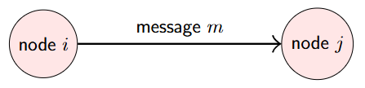
Distributed Systems and Computer Networking
We use a simple abstraction of communication:
Reality is much more complex:
Various network operators: eduroam, home DSL, cellular data, coffee shop wifi, submarine cable, satellite. . .
Physical communication: electric current, radio waves, laser, hard drives in a van. . .

Slide 8
Latency and Bandwidth
Latency: time until message arrives
In the same building/datacenter: ≈ 1 ms
One continent to another: ≈ 100 ms
Hard drives in a van: ≈ 1 day
Bandwidth: data volume per unit time
3G cellular data: ≈ 1 Mbit/s
Home broadband: ≈ 10 Mbit/s
Hard drives in a van: 50 TB/box ≈ 1 Gbit/s
(Very rough numbers, vary hugely in practice!)

Slide 9
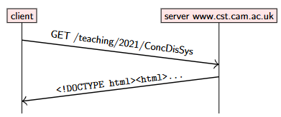
Client-server example: the web
Time flows from top to bottom.

Slide 10
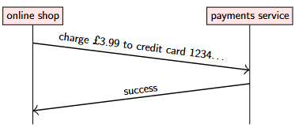
Client-server example: online payments

Slide 11
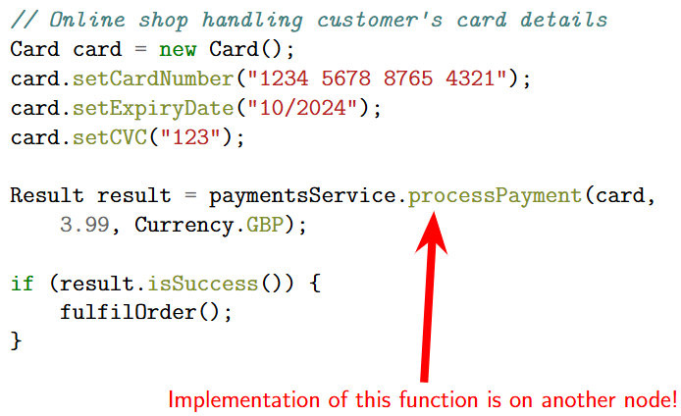
Remote Procedure Call (RPC) example

Slide 12
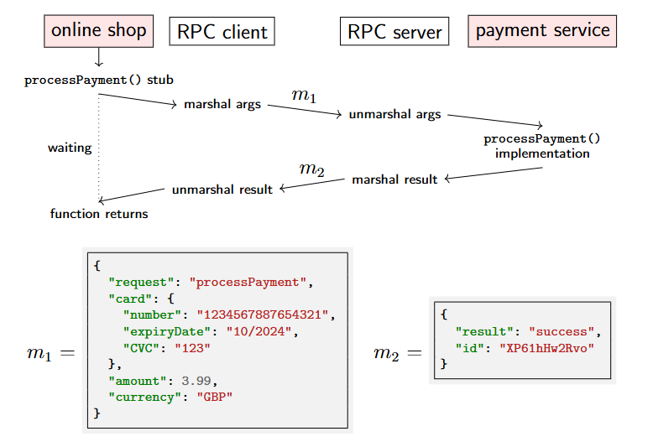

Slide 13
Remote Procedure Call (RPC)
Ideally, RPC makes a call to a remote function look the same as a local function call.
“Location transparency”: system hides where a resource is located.
In practice. . .
what if the service crashes during the function call?
what if a message is lost?
what if a message is delayed?
if something goes wrong, is it safe to retry?

Slide 14
RPC history
SunRPC/ONC RPC (1980s, basis for NFS)
CORBA: object-oriented middleware, hot in the 1990s
Microsoft’s DCOM and Java RMI (similar to CORBA)
SOAP/XML-RPC: RPC using XML and HTTP (1998)
Thrift (Facebook, 2007)
gRPC (Google, 2015)
REST (often with JSON)
Ajax in web browsers

Slide 15
RPC in enterprise systems
“Service-oriented architecture” (SOA) / “microservices”:
splitting a large software application into multiple services(on multiple nodes) that communicate via RPC.
Different services implemented in different languages:
interoperability: datatype conversions
Interface Definition Language (IDL): language-independent API specification

Slide 16
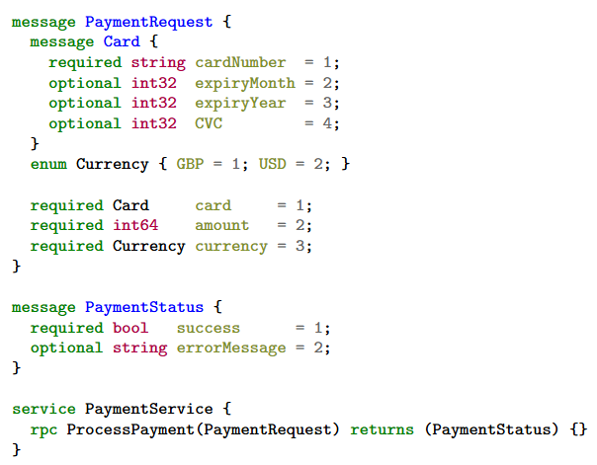
gRPC IDL example

Slide 17
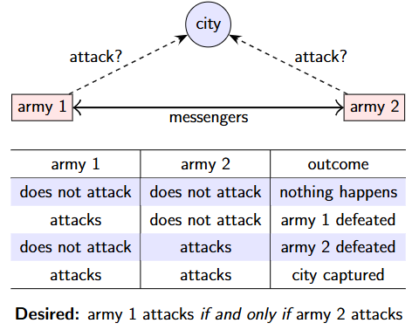
The two generals problem

Slide 18
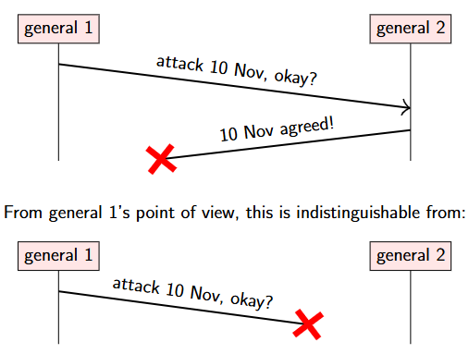
The two generals problem

Slide 19
How should the generals decide?
1. General 1 always attacks, even if no response is received?
Send lots of messengers to increase probability that one will get through
If all are captured, general 2 does not know about the attack, so general 1 loses
2. General 1 only attacks if positive response from general 2 is received?
Now general 1 is safe
But general 2 knows that general 1 will only attack if general 2’s response gets through
Now general 2 is in the same situation as general 1 in option 1
No common knowledge: the only way of knowing something is to communicate it

Slide 20
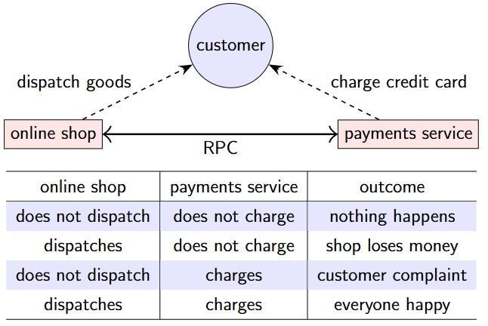
The two generals problem applied
Desired: online shop dispatches if and only if payment made

Slide 21
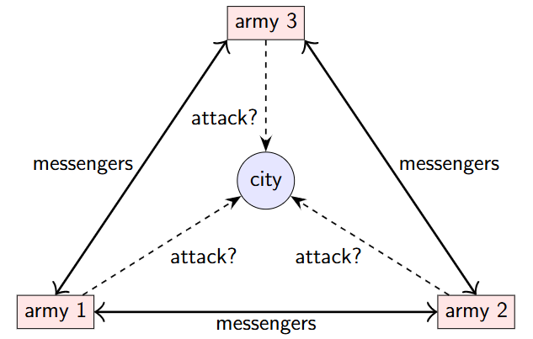
The Byzantine generals problem

Slide 22
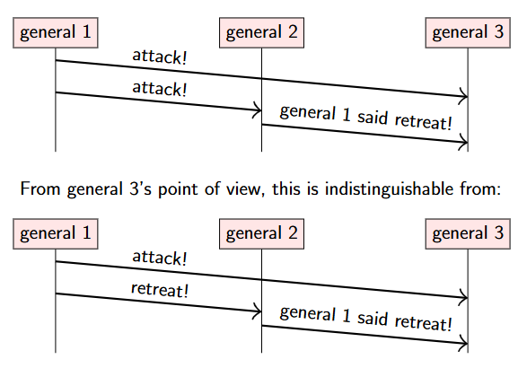
Generals that might lie

Slide 23
The Byzantine generals problem
Up to f generals might behave maliciously
Honest generals don’t know who the malicious ones are
The malicious generals may collude
Nevertheless, honest generals must agree on plan
Theorem: need 3f + 1 generals in total to tolerate malicious generals (i.e. < 13 may be malicious)
Cryptography (digital signatures) helps – but problem remains hard

Slide 24
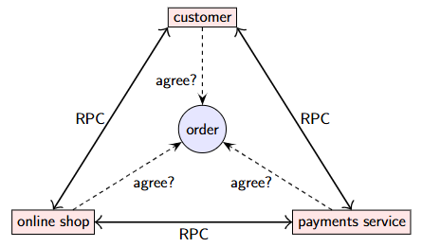
Trust relationships and malicious behaviour

Slide 25
System models
We have seen two thought experiments:
Two generals problem: a model of networks
Byzantine generals problem: a model of node behaviour
In real systems, both nodes and networks may be faulty!
Capture assumptions in a system model consisting of:
Network behaviour (e.g. message loss)
Node behaviour (e.g. crashes)
Timing behaviour (e.g. latency)
Choice of models for each of these parts.

Slide 26
Networks are unreliable
In the sea,
sharks bite fibre optic cables https://slate.com/technology/2014/08/shark-attacks-threaten-google-s-undersea-internet-cables-video.html
On land,
cows step on the cables https://twitter.com/uhoelzle/status/1263333283107991558

Slide 27
System model: network behaviour
Assume bidirectional point-to-point communication between two nodes, with one of:
Reliable (perfect) links:
A message is received if and only if it is sent.
Messages may be reordered.
Fair-loss links:
Messages may be lost, duplicated, or reordered.
If you keep retrying, a message eventually gets through.
Arbitrary links (active adversary):
A malicious adversary may interfere with messages(eavesdrop, modify, drop, spoof, replay).
Network partition: some links dropping/delaying all messages for extended period of time

Slide 28
System model: node behaviour
Each node executes a specified algorithm, assuming one of the following:
Crash-stop (fail-stop):
A node is faulty if it crashes (at any moment). After crashing, it stops executing forever.
Crash-recovery (fail-recovery):
A node may crash at any moment, losing its in-memory state. It may resume executing sometime later.
Byzantine (fail-arbitrary):
A node is faulty if it deviates from the algorithm.
Faulty nodes may do anything, including crashing or malicious behaviour.
A node that is not faulty is called “correct”

Slide 29
System model: synchrony (timing) assumptions
Assume one of the following for network and nodes:
Synchronous:
Message latency no greater than a known upper bound.
Nodes execute algorithm at a known speed.
Partially synchronous:
The system is asynchronous for some finite (but unknown) periods of time, synchronous otherwise.
Asynchronous:
Messages can be delayed arbitrarily.
Nodes can pause execution arbitrarily.
No timing guarantees at all.
Note: other parts of computer science use the terms“synchronous” and “asynchronous” differently.

Slide 30
Violations of synchrony in practice
Networks usually have quite predictable latency, which can occasionally increase:
Message loss requiring retry
Congestion/contention causing queueing
Network/route reconfiguration
Nodes usually execute code at a predictable speed, with occasional pauses:
Operating system scheduling issues, e.g. priority inversion
Stop-the-world garbage collection pauses
Page faults, swap, thrashing
Real-time operating systems (RTOS) provide scheduling guarantees, but most distributed systems do not use RTOS

Slide 31
System models summary
For each of the three parts, pick one:
Network: reliable, fair-loss, or arbitrary
Nodes: crash-stop, crash-recovery, or Byzantine
Timing: synchronous, partially synchronous, or asynchronous
This is the basis for any distributed algorithm. If your assumptions are wrong, all bets are off!

Slide 32
Attribution
Today’s lecture is based on lecture on Martin Kleppmann’s Distributed System Lecture Series

Slide 33
Agenda
Logical Clocks
Lamport Clocks
Vector Clocks

Slide 34
A Detective Story
30 June – 1 July 2012, midnight UTC
Hundreds of services crashed simultaneously.
Airlines couldn't process reservations for hours.
Reddit, LinkedIn, Mozilla, Yelp — all went down.
A reboot didn't fix it. Setting the system clock did.
What caused a simultaneous global outage?

Slide 35
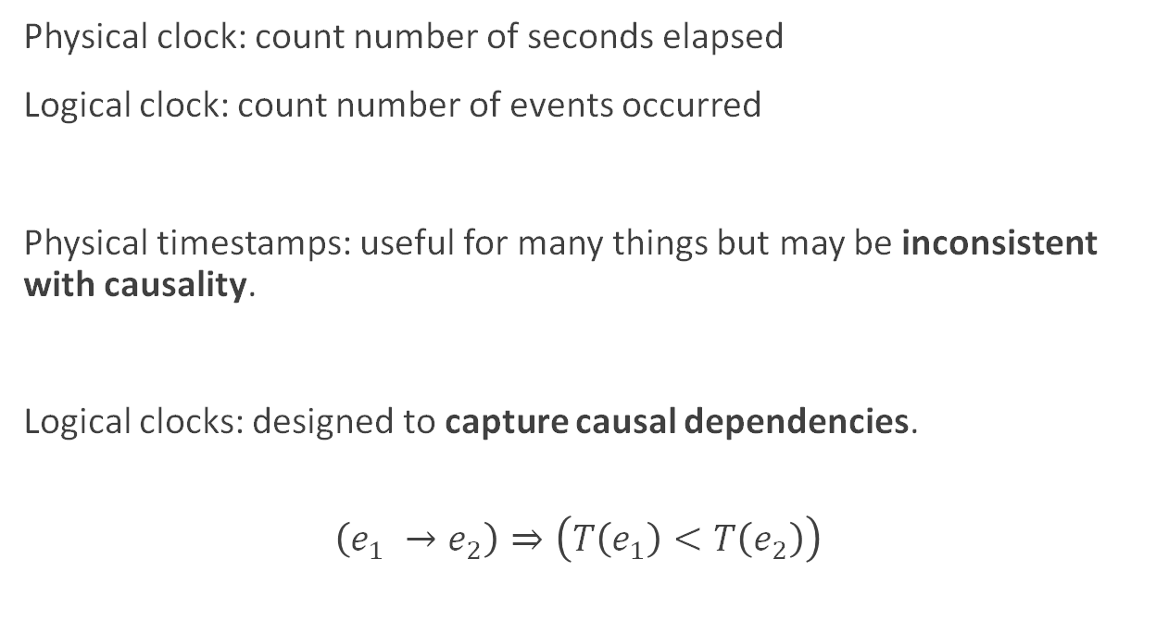
Logical vs. physical clocks
Physical clock: count number of seconds elapsed
Logical clock: count number of events occurred
Physical timestamps: useful for many things but may be inconsistent with causality.
Logical clocks: designed to capture causal dependencies.
$$\left(e_{1} →e_{2}\right)⇒\left(T\left(e_{1}\right)<T\left(e_{2}\right)\right)$$

Slide 36
Types of Physical Clocks
Quartz Clock
Vibrating crystal oscillates at a fixed frequency
Found in every phone, PC, and microwave
Drift: ~50 ppm = 4.3 s/day
Atomic Clock
Caesium-133 resonance at ~9.2 GHz
1 second = 9,192,631,770 cycles
Accuracy: 1 sec in 3 million years | Cost: ~£20k
GPS/GNSS
31 satellites with atomic clocks broadcast precise time. Datacenter antennas achieve sub-microsecond accuracy.

Slide 37
UTC & The Leap Second Problem
International Atomic Time (TAI) — pure atomic clock time
Mean solar time (UT1) — based on Earth's rotation
UTC – TAI + leap second corrections — our global standard
Leap Seconds
Added (or rarely removed) on June 30 or Dec 31 at 23:59:59 UTC
27 leap seconds added since 1972 — Earth is slowing down!
Unix time ignores leap seconds — software that assumes 86,400 s/day can break
2012 incident: a Linux kernel bug triggered by the leap second caused a livelock

Slide 38

Lamport clocks algorithm
on initialisation do
$t ≔0$ Each node has its own local variable t
end on
on any event at the local node do
$t ≔t+1$
end on
on request to send message m do
$t ≔t+1$; send (t, m) via the underlying network link
end on
on receiving (t', m) via the underlying network link do
$t ≔\max\left(t,t^{′}\right)+1$
deliver m to the application
end on

Slide 39
Lamport clocks in words
Each node maintains a counter t, incremented on every local event c
Let L(e) be the value of t after that increment
Attach current t to messages sent over network
Recipient moves its clock forward to timestamp in the message (if greater than local counter), then increments
Properties of this scheme:
If a → b then L(a) < L(b)
However, L(a) < L(b) does not imply a —+ b
Possible that L(a) = L(b) for a ≠ b

Slide 40
The Happens-Before Relation
a → b means "a happened before b“
Same node
If a and b are on the same node and a occurs before b in program order, then a → b
Message passing
If a = send(m) and b = recv(m) for the same message, then a → b
Transitivity
If a → b and b → c, then a → c
Concurrent: a ∥ b if neither a → b nor b → a (no causal relationship)

Slide 41
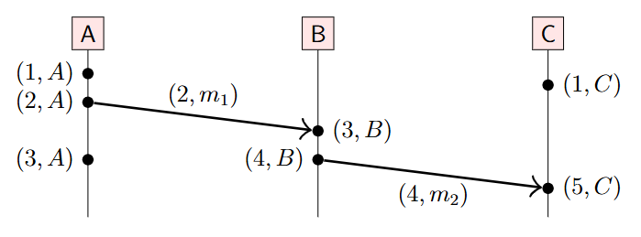
Lamport clocks example
Let N (e) be the node at which event e occurred.
Then the pair (L(e), N (e)) uniquely identifies event e.
Define a total order ≺ using Lamport timestamps: (a ≺ b) ⇐⇒ (L(a) < L(b) ∨ (L(a) = L(b) ∧ N (a) < N (b)))
This order is causal: ( a → b) =⇒ (a ≺ b)

Slide 42
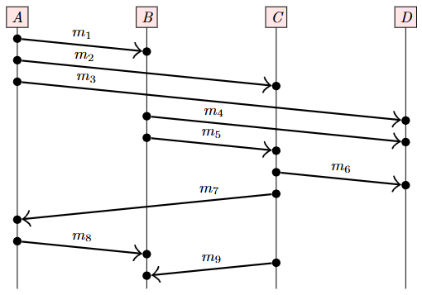
Exercise
Given the sequence of messages in the following execution, show the Lamport timestamps at each send or receive event.

Slide 43
Question
Given the Lamport timestamps of two events, is it possible to tell whether those events are concurrent or whether one happened before the other?

Slide 44
Vector Clocks
Given Lamport timestamps L(a) and L(b) with L(a) < L(b) we can’t tell whether a → b or a ‖ b.
If we want to detect which events are concurrent, we need vector clocks:
Assume n nodes in the system, N = 〈N1, N2, . . . , Nn〉
Vector timestamp of event a is V (a) =〈t1, t2, . . . , tn〉
ti is number of events observed by node Ni
Each node has a current vector timestamp T
On event at node Ni, increment vector element T [i]
Attach current vector timestamp to each message
Recipient merges message vector into its local vector

Slide 45
Vector Clocks
on initialisation at node Ni do T := 〈0, 0, . . . , 0〉 local variable at node Ni end on
on any event occurring at node Ni do T [i] := T [i] + 1 end on
on request to send message m at node Ni do T [i] := T [i] + 1; send (T, m) via network end on
on receiving (T ′, m) at node Ni via the network do
T [j] := max(T [j], T ′[j]) for every j ∈ {1, . . . , n} T [i] := T [i] + 1; deliver m to the application end on

Slide 46
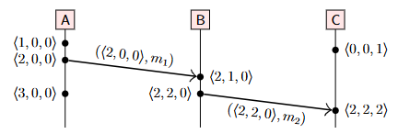
Vector clocks example
The vector timestamp of an event e represents a set of events, e and its causal dependencies: {e} ∪ {a | a → e}
For example, 〈2, 2, 0〉 represents the first two events from A, the first two events from B, and no events from C.

Slide 47
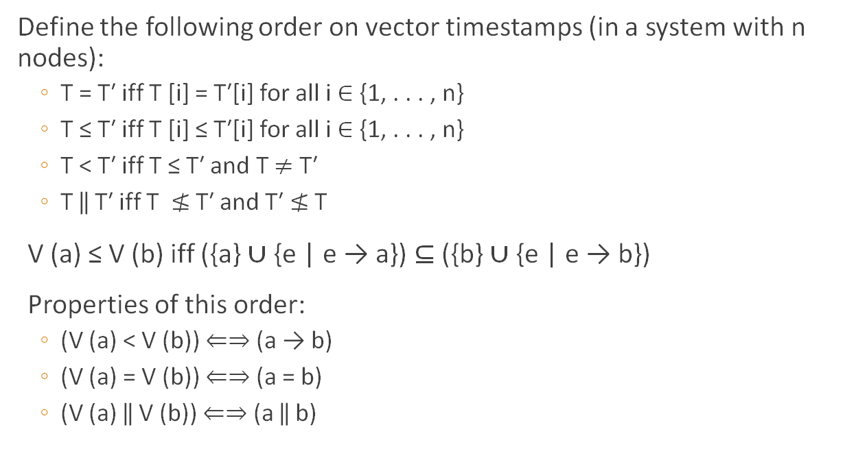
Vector clocks ordering
Define the following order on vector timestamps (in a system with n nodes):
T = T′ iff T [i] = T′[i] for all i ∈ {1, . . . , n}
T ≤ T′ iff T [i] ≤ T′[i] for all i ∈ {1, . . . , n}
T < T′ iff T ≤ T′ and T $≠$ T′
T ‖ T′ iff T $≰$ T′ and T′ $≰$ T
V (a) ≤ V (b) iff ({a} ∪ {e | e → a}) ⊆ ({b} ∪ {e | e → b})
Properties of this order:
(V (a) < V (b)) ⇐⇒ (a → b)
(V (a) = V (b)) ⇐⇒ (a = b)
(V (a) ‖ V (b)) ⇐⇒ (a ‖ b)

Slide 48
Exercise
Show the vector clocks at each send or receive event..

